Slide 1

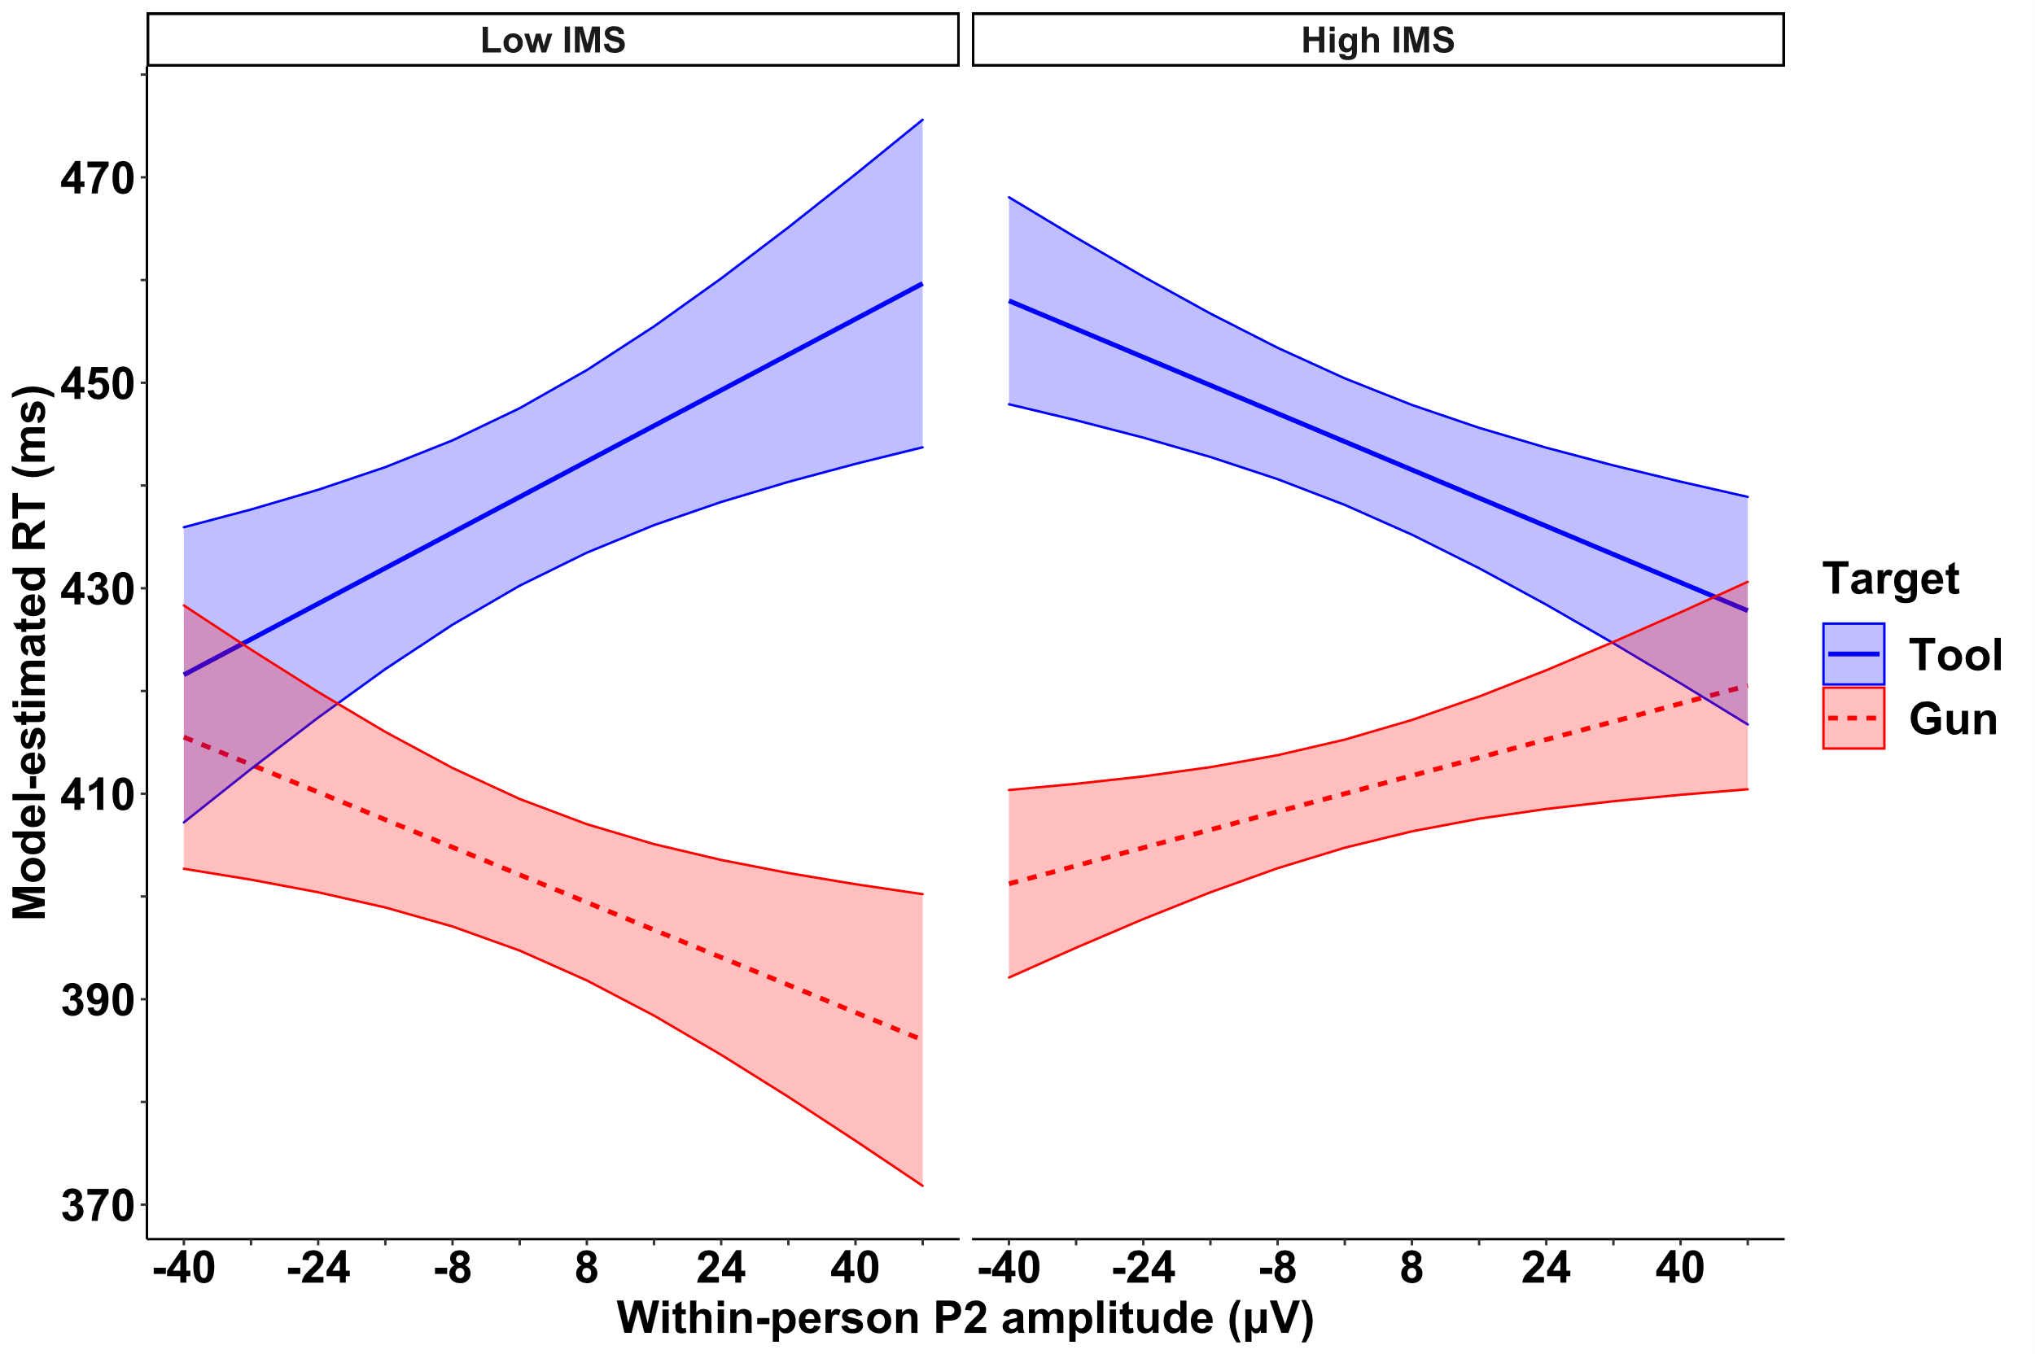
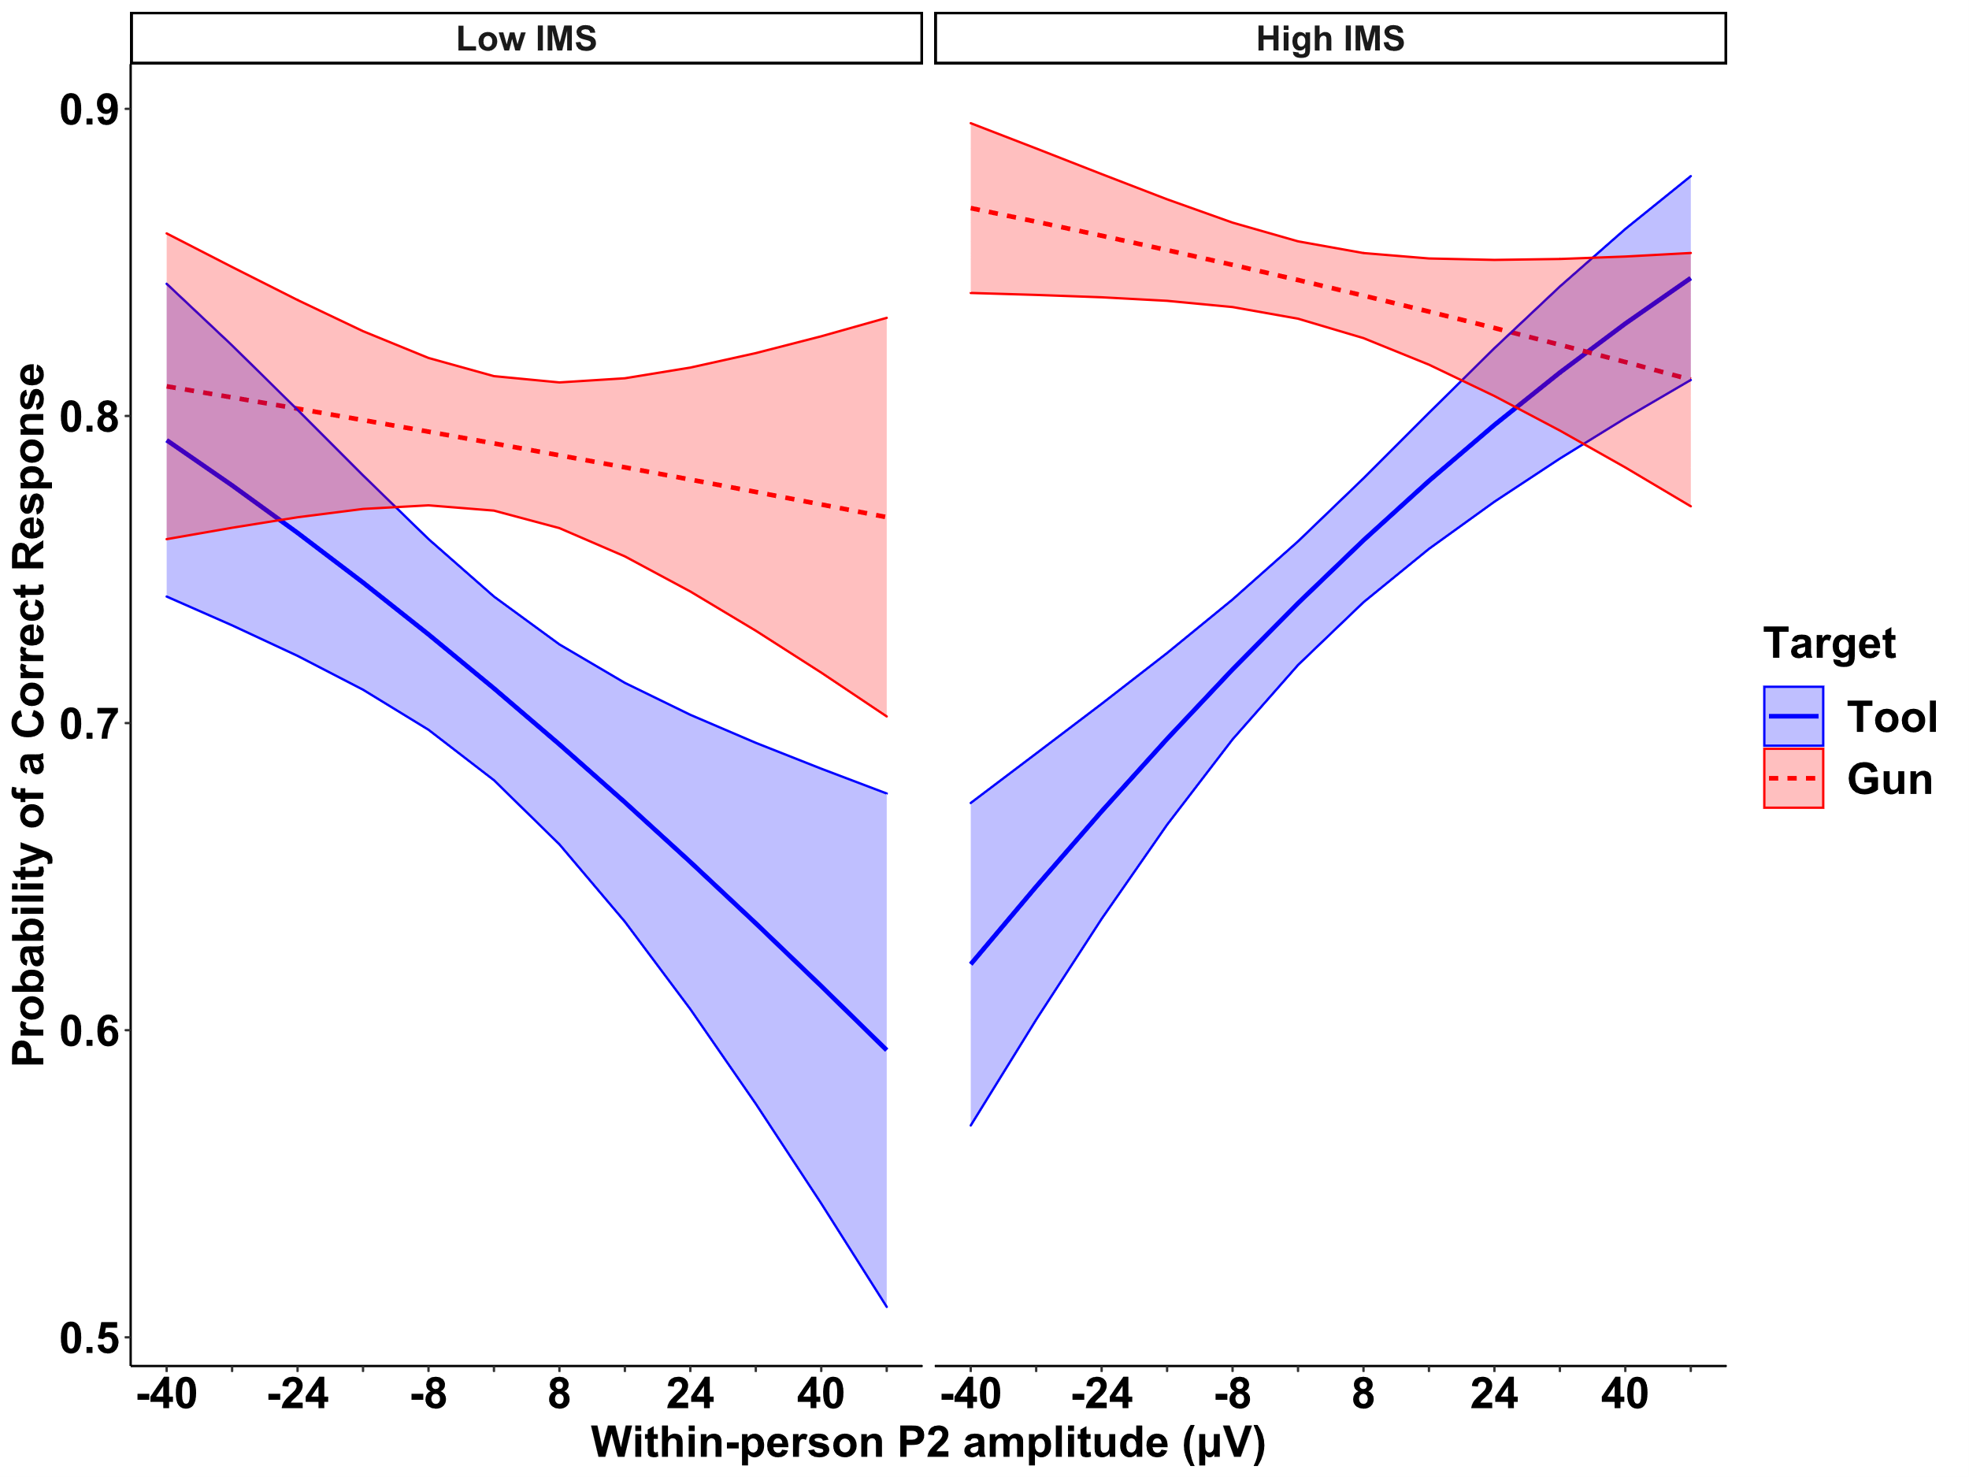
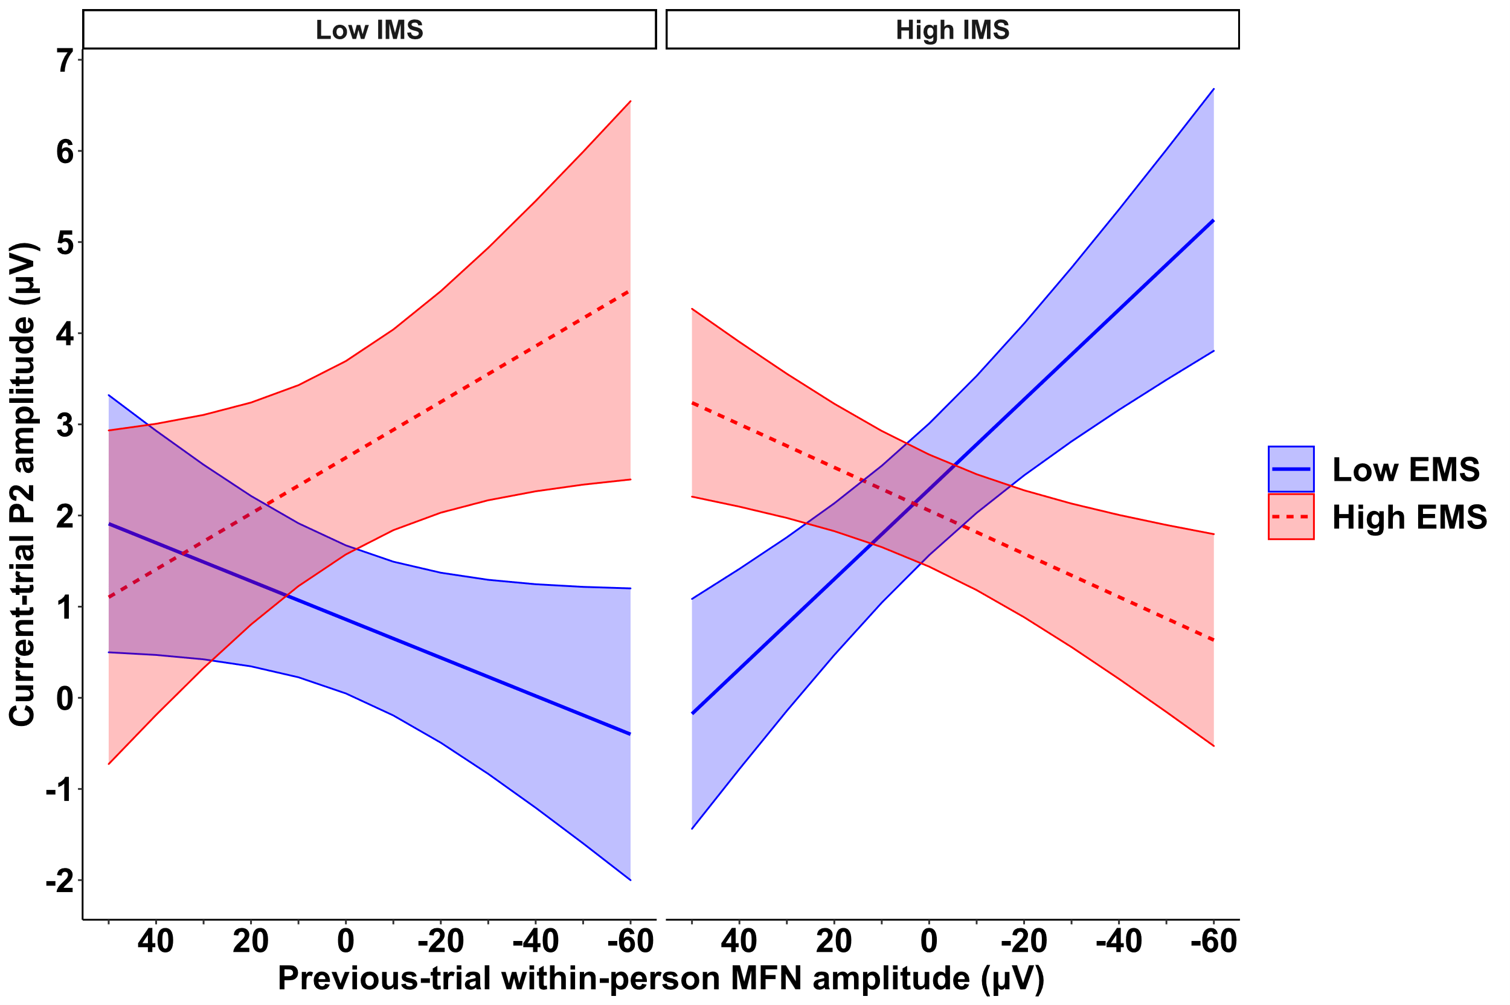
Face processing and the expression of race bias: Effects of between-
and within-person variability in motivation to engage control
Omnibus test: IMS x P2 x Target on RT on a given trial,
z = -2.39, p = .017
Paul J. Brancaleone, M.S.¹, Roberto U. Cofresi, PhD², Hannah I. Volpert-Esmond, PhD³, David M. Amodio, PhD⁴, Tiffany A. Ito, PhD⁵, & Bruce D. Bartholow, PhD¹
z = -2.10,
p = .036
University of Iowa¹, University of Missouri², University of Texas- El Paso³, University of Amsterdam⁴, University of Colorado- Boulder⁵
z = 2.01,
p = .036
INTRO
Discrepancies in attention to race (i.e., greater P2 amplitudes to Black vs. White faces) predicts greater behavioral bias on implicit bias tasks.¹⁻⁶ However, low-prejudice individuals use race as a vigilance cue for control.^{2, 7} Greater response conflict (i.e., larger MFN amplitudes) on stereotype-congruent trials signals the need for control⁸, especially among those internally motivated (but not externally motivated) to control race bias.⁹
Person construal^{10, 11} and neurocognitive control^{12, 13} over race bias are dynamic processes that vary within-persons over time, but are seldom studied with dynamic methods- rather, task-averages are examined.
Trial-by-trial, how do these dynamic processes unfold sequentially to produce response control over race bias?
For those internally motivated, (1) greater within-person P2 amplitudes to Black faces will predict less biased responses within a trial, and (2) larger within-person MFN amplitudes on the previous trial should predict larger P2 amplitudes on the next trial.
Only the High IMS-Tool simple slope approached significance,
z = -1.76, p = .079.
Omnibus test: IMS x P2 x Target on the probability of a correct response on a given trial,
z = 1.81, p = .07
z = 2.54,
p = .011
METHODS
Participants (N = 139), a subset of a larger, multi-site study,¹⁴ completed 3 implicit bias tasks with EEG recorded (130 White, 6 Black, 9 Asian, 4 Hispanic/Latinx, M(SD)_{age} = 19.74(1.81), 82 Male, 57 Female).
We examined data from the Weapons Identification Task¹⁵ (384 experimental trials, 500ms response deadline).
Participants completed the Internal and External Motivation to Respond Without Prejudice Questionnaire¹⁶ (10 items, 5 per subscale); e.g., “I try to act nonprejudiced toward Black people because of pressure from others” (EMS); “Being nonprejudiced toward Black people is important to my self-concept” (IMS).
We disaggregated between- and within-person variance¹⁷⁻¹⁸ in ERP measures to derive trial-to-trial fluctuations in attention to race (P2) and conflict monitoring (MFN).
We conducted multilevel models¹⁸ to examine trial-level effects within-persons and tested Tool – Gun contrasts of model-estimated slopes, Tukey-adjusted; Only Black-prime trials were considered to reduce model complexity (see supplement).
z = -0.82,
p = .415
Only the High IMS-Tool simple slope was significant,
z = 2.80, p = .005.
DV: 1 = Correct, 0 = Incorrect
IMS x EMS x Previous-trial MFN interaction on the current-trial P2 amplitude elicited by Black face primes, z = 1.81, p = .07
z = 1.13,
p = .259
z = -2.30,
p = .022
DISCUSSION
Those high in IMS utilize race as a vigilance cue to exert control over race bias^{2, 7}, evidenced by greater P2 amplitudes predicting smaller discrepancies in RT/accuracy to tools vs. guns on Black-prime trials.
Greater internalization of motivations to be nonprejudiced is associated with greater sensitivity to conflict-related signals.
Dynamic modeling of within-person effects can help to elucidate the relationships between face processing and bias control.
Only the High IMS-Low EMS simple slope was significant,
z = -2.38, p = .017.
For the reference list and supplementary information: github.com/pb865/SPSP2024/blob/main/References%20and%20Supplument.docx
Connect with me! E: pbrancaleone@uiowa.edu
L: linkedin.com/in/paul-brancaleone-1810a6164
This work was supported by NSF grant BCS 0847872 (T. A. I. & B. D. B.)
Notes:
Notes:
Keep text within gutter guides.
To hide guides: click View; uncheck Guides
Author list: Don’t split names onto two lines (e.g., “Jimmy [break] Smith”). If that happens, use a new line. Bold the first names of the presenting author.
Intro/methods/result: Don’t drop below font size 10, but if you have extra space, increase the font size until the space is full.
Do not use color in the sidebars except in graphs/figures.

